Slide 1





Slide 2

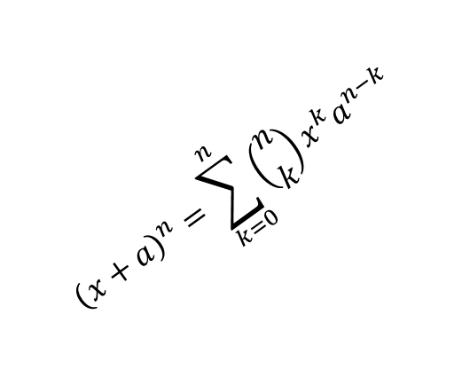
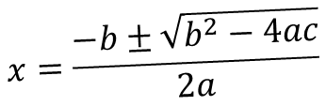
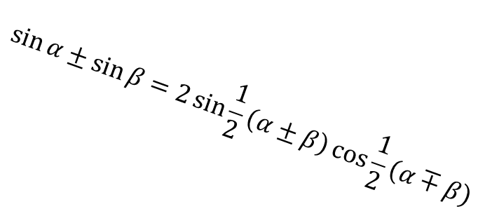
$$x=\frac{−b±\sqrt{b^{2}−4ac}}{2a}$$
gravity
$${\left(x+a\right)}^{n}=\sum_{k=0}^{n}{\left({n \atop k}\right)x^{k}a^{n−k}}$$
$$\sin{α}±\sin{β}=2\sin{\frac{1}{2}\left(α±β\right)}\cos{\frac{1}{2}\left(α∓β\right)}$$

